Slide 1
Capstone Project - Exploratory Data Analysis
AirBnb Booking Analysis
(BY Pritam Sonawane)

Slide 2


Slide 3
Table of Content
Introduction of Airbnb
Data Summary & Variables
Exploratory Data Analysis
Conclusion

Slide 4
Introduction of Airbnb
Airbnb was Founded in 2008 by Brian Chesky, Joe Gebbia, Nathan Blecharczyk
Airbnb is an online marketplace connecting traveler with local hosts. On one side, the platform enables people to list their available space and earn extra income in the form of rent. On the other , Airbnb enables traveler to book unique homestays from local host, saving them money and giving them a chance to interact with locals. Catering to the on-demand travel industry , Airbnb is present in over 190 countries across the world . Airbnb does not own any the listed properties.
Airbnb offer around 6 million places to stay in throughout the world. At any given time , guest book 1.9 million listing in Airbnb.
Here we are going to do an Exploratory Data Analysis on the data set Airbnb(2019).
This dataset has around 49,000 observation in its with 16 columns and it is a mix between categorical and numeric values.
Our main objectives of analysis will be the some of the statement given to us which can be briefed as learning from hosts , areas, price , reviews, locations etc. But we are not limited to it , we will also try to explore some more insights.

Slide 5
Data Summary & Variables
Unique
Id
Host_id
Date
Last_review
Categorical
Name
Host_name
Neighbourhood
Neighbourhood_Group
Room_type
Numeric
Latitude
Longitude
Price
Minimum_night
Number_of_reviews
Calculated_host_listing_count
Availablity_365
AirBnb Data

Slide 6
Data Summary and Variables
Id: Its a unique id for House/apartment.
Name : Name of the listing house /apartment.
Host Id : Host id is the government approve id for each individuals who rent their properties on Airbnb.
Host Name : Host names are basically the name of the individual or organization who Own a room/ apartment on Airbnb website.
Neighborhood Groups : Neighborhood group are the cluster of neighborhoods in the area. There are about 5 boroughs in the state.
Neighborhood : When searching for accommodation in a city ,guests are able to filter by neighborhood attributes and explore layer of professional-quality content ,including neighborhood maps ,custom local photography and localized editorial ,details on public transportation and parking tips from Airbnb's host community.
Latitude: Latitude is the measurement of distance north and south of equator.
Longitude : longitude is the measurement east or west of the prime meridian.

Slide 7
Room type : Airbnb has 3 categories for types od space:
Entire House/Apartment
Private room
shared room
Price : The total price($) of Airbnb reservation is based on the rate set by the Host, plus fee or costs determined by either the Host or Airbnb.
Minimum nights : Minimum night is criteria for booking that guest have to pay for book that House/Room or apartment.
Number of reviews : Number of review of each host submitted by guest. last review : Latest review submitted b y guest as a feedback.
Availability 365:It is an indicator of the total number of days the listing is available for during the year.

Slide 8
Exploratory Data Analysis
What is EDA ?
Exploratory Data Analysis is very important in machine learning. Whenever we start our work on any project we must analyze the factors deeply. Hypothetical questions and that hypothetical questions lead to some hidden facts. This collaborative work is simply known as EDA.
The following steps are involved in the process of EDA:
Acquire and loading data
Understanding the variables
cleaning dataset
exploring and visualizing data
Analyzing relation between variables
Graphs used for EDA
Type of graphs we have used for data visualization:
Pie Plot
Bar plot
Scatter plot
Histograms plot
Box plot

Slide 9
Libraries used for EDA:
Python Libraries we used for graphs
Matplotlib
seaborn
NumPy
Pandas

Slide 10
Points for Discussion
Airbnb Data
Neighborhood group based on Latitude and Longitude
Room Types and Neighborhood Group
Top 10 Apartment listings
Exploration of Neighborhood Group
Price Exploration
Average room rent for locality
Expensive Neighborhood
Number of locality listed
Location and Review Score
Top 5 host
Price based on the Availability 365
Conclusion & Problem statement.

Slide 11
AirBnb
Dataset
Now we need to check how many rows and columns the dataset is having. It is also necessary to check how many unique values are present for each column. For this we will also use the unique.
So we have the 48895 rows and 16 columns.
id | 48895
name | 47905
host_id | 37457
host_name | 11452
neighbourhood_group | 5
neighbourhood | 221
latitude | 19048
longitude | 14718
room_type | 3
price | 674
minimum_nights | 109
number_of_reviews | 394
last_review | 1764
reviews_per_month | 937
calculated_host_listings_count | 47
availability_365 | 366

Slide 12
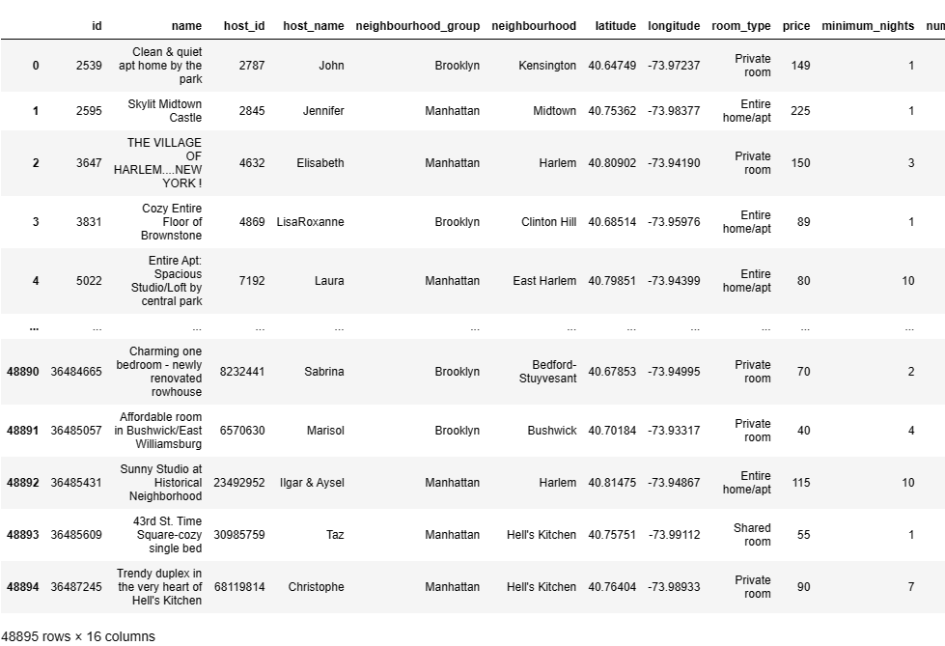
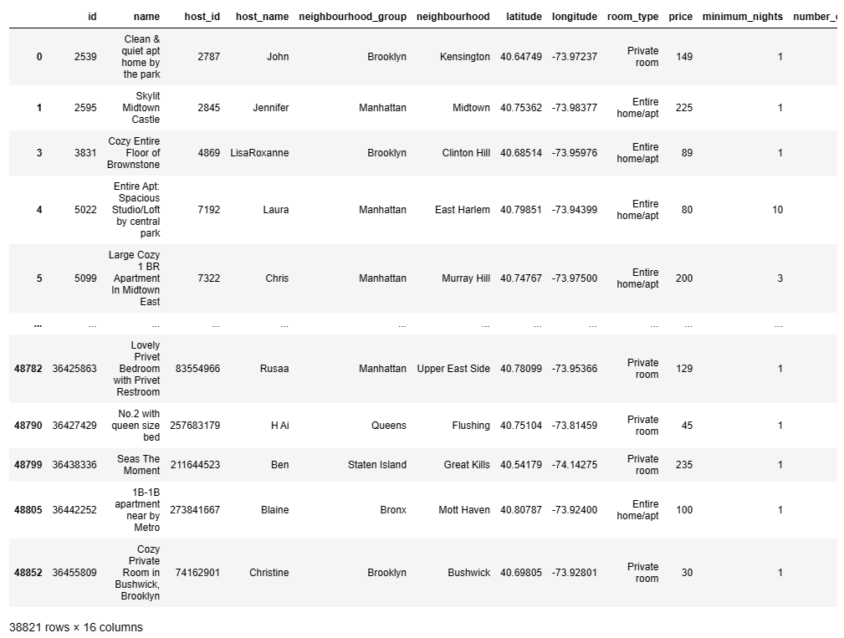
EDA
1. Let’s Check the null values in dataset.
2. As we can see in data column 'last_review & review_per_month’ having a large number of null values.
3. Before remove null values 48895 rows and 16 columns.
4. After removed null values 38821 rows and 16 columns.
Before remove Null values
After removed Null values

Slide 13
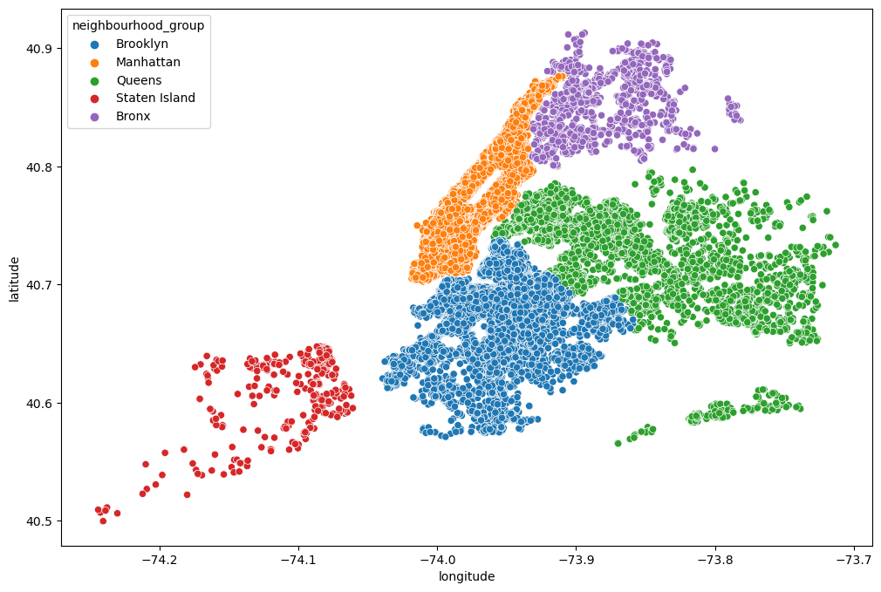
Scatter Plot to show the neighborhood group based on Latitude and Longitude
We will plot the same latitude and longitude in a scatter plot to have the cluster of the location, the same we did with the folium maps.
Unique Values
It is very important to understand and analyze the Unique values, this gives a lot of insight to the data and the user preference for a particular choice. We will take Room Type and Neighborhood group
From the below, we have 3 types of room in the dataset and 5 different neighborhood group. In the next section we will explore more on these two categories to understand the user distribution.
Unique value for room_type are | Private room , Entire home/apt , Shared room
Unique value for neighbourhood_group are | Brooklyn , Manhattan , Queens , Staten Island , Bronx

Slide 14
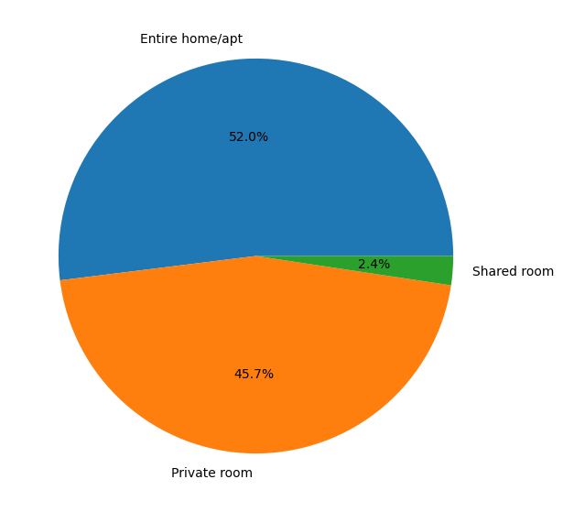
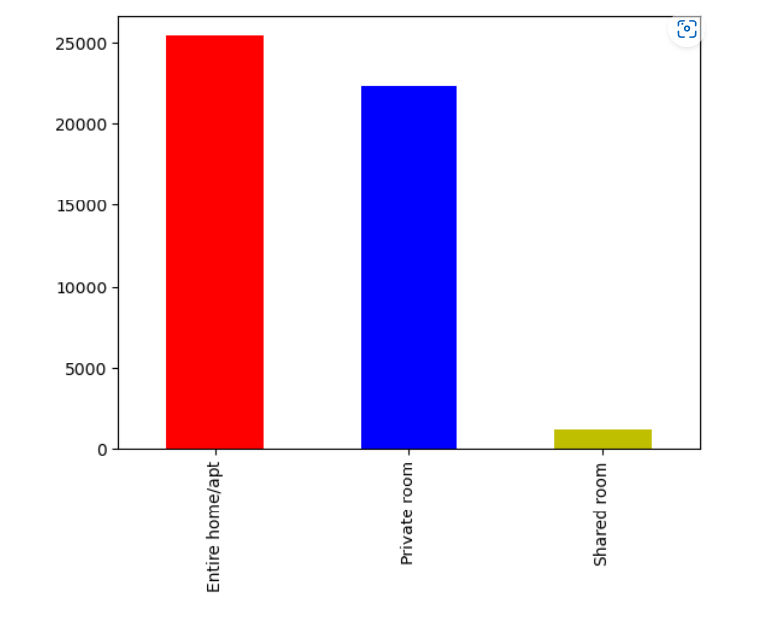
Room Types and Neighborhood Group
We will first check the distribution of the room type by grouping the data. From the below its clear the Apartment and Private data is more than that of shared rooms. In general, Shared rooms costs less and can be very useful for travelers who moves from one city to another city quite frequently. Though the shared rooms data is less, we will still try to uncover as much details as we can.

Slide 15
Top 10 Apartment listings
Below i am displaying the Entire Home/Apartment renting and it looks odd that Sonder(NYC) have itself is too high. We will also list out only the details for the user if they are genuine hotels or there is any discrepancy in the data. We will use the latitude and longitude of the data to find out.
ID | HOST_ID | HOST_NAME | NEIGHBOURHOOD | NEIGHBOURHOOD_GROUP | APARTMENT
20211 | 219517861 | Sonder (NYC) | Financial District | Manhattan | 210
6449 | 7503643 | Vida | Greenpoint | Brooklyn | 52
8430 | 12243051 | Sonder | Financial District | Manhattan | 51
20214 | 219517861 | Sonder (NYC) | Murray Hill | Manhattan | 50
19900 | 205031545 | Red Awning | Midtown | Manhattan | 49
17832 | 120762452 | Stanley | Murray Hill | Manhattan | 49
12273 | 30283594 | Kara | Hell's Kitchen | Manhattan | 41
17451 | 107434423 | Blueground | Chelsea | Manhattan | 37
12275 | 30283594 | Kara | Midtown | Manhattan | 33
17628 | 113805886 | Yaacov | Upper East Side | Manhattan | 33

Slide 16
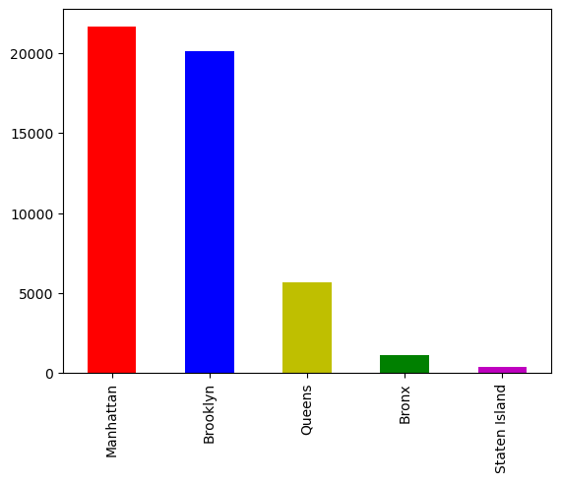
Exploration of Neighborhood Group
Let's explore the neighborhood group now to see the data distribution. From the below it looks like Manhattan and Brooklyn has more number of listing that the Queens, Bronx and Staten island.

Slide 17
Lets see…
ID | HOST-ID | HOST_NAME | NEIGHBOURHOOD | PRIVATE
15261 | 190921808 | John | Hell's Kitchen | 44
14025 | 137358866 | Kazuya | Woodside | 35
16301 | 238321374 | Eyal | Upper West Side | 32
15984 | 224414117 | Gabriel | Hell's Kitchen | 30
16035 | 226410657 | Nina | Bedford-Stuyvesant | 26
16144 | 230192510 | Zach | Fort Greene | 25
16386 | 242962235 | Yuval | Ridgewood | 23
16539 | 252604696 | Erin | Chelsea | 20
15761 | 216235179 | Nina | Bushwick | 17
14024 | 137358866 | Kazuya | Sunnyside | 17
 |  | Top 10 Private room
1 . Sonder (NYC) Seeing the below latitude and longitude it is clear that it is in the same building.
2 . Top 10 Private room We will do it for both Private room and Shared room and also will check for the top hoteliers if it is the same location or it is spread out.
3 . Location wise Private room
4 . Shared Room Exploration
ID | HOST_ID | HOST_NAME | NEIGHBOURHOOD | LATITUDE | LONGITUDE
0 | 2787 | John | Kensington | 40.64749 | -73.97237
429 | 715807 | John | Greenwich Village | 40.72831 | -74.00177
620 | 1229984 | John | Long Island City | 40.74581 | -73.95295
991 | 1488809 | John | Bushwick | 40.70339 | -73.92945
1141 | 2397411 | John | Clinton Hill | 40.68545 | -73.96534
 |  | Location wise Private room
ID | HOST_ID | HOST_NAME | NEIGHBOURHOOD | LATITUDE | LONGITUDE
38293 | 219517861 | Sonder (NYC) | Financial District | 40.70637 | -74.00645
38294 | 219517861 | Sonder (NYC) | Financial District | 40.70771 | -74.00641
38588 | 219517861 | Sonder (NYC) | Financial District | 40.70743 | -74.00443
39769 | 219517861 | Sonder (NYC) | Murray Hill | 40.74792 | -73.97614
39770 | 219517861 | Sonder (NYC) | Murray Hill | 40.74771 | -73.97528
 |  | Sonder (NYC)
ID | HOST_ID | HOST_NAME | NEIGHBOURHOOD | SHARED
339 | 39528519 | Max | Lower East Side | 23
529 | 119669058 | Melissa | Bedford-Stuyvesant | 18
651 | 201015598 | Anchor | Bedford-Stuyvesant | 17
618 | 175730239 | Baboucarr | Sunnyside | 10
663 | 209386156 | Abraham | East Harlem | 9
727 | 253906467 | Erik | Hell's Kitchen | 9
686 | 223087887 | Jess & Ana | Corona | 8
714 | 248161322 | Sergii | Bushwick | 8
292 | 30509656 | Orit | Port Morris | 8
635 | 187975743 | R.Henry | Hell's Kitchen | 8
 |  | Shared Room Exploration

Slide 18
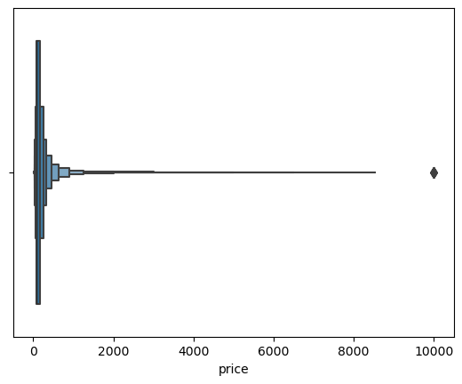
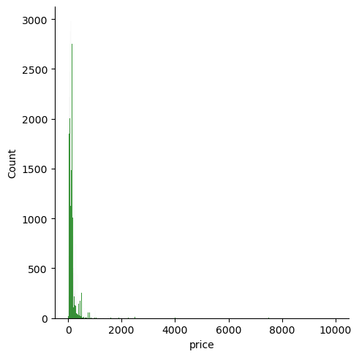
Price Exploration
We will check if there is any null value presenting the price column and from the below, it looks like we don't have any null value to take care of.
Let's have a quick summary of the price data. In according to the summary statistics it is clear that the Price ranges from 0−180. But there also exists price which has a maximum of $10000. This we cannot discard as an outlier because there are many scenarios in which price differs. The price varies on different factors which includes location, room type, neighborhood , season etc. Also, we can see from the below there are few values with 0, which can be due to dynamic pricing or the willingness of not to share the price with the Airbnb. We also plot a boxplot to understand how the data is spread out for high ranges for the price irrespective of region.
count | 48895
mean | 152.720687
std | 240.15417
min | 0
25% | 69
50% | 106
75% | 175
max | 10000

Slide 19
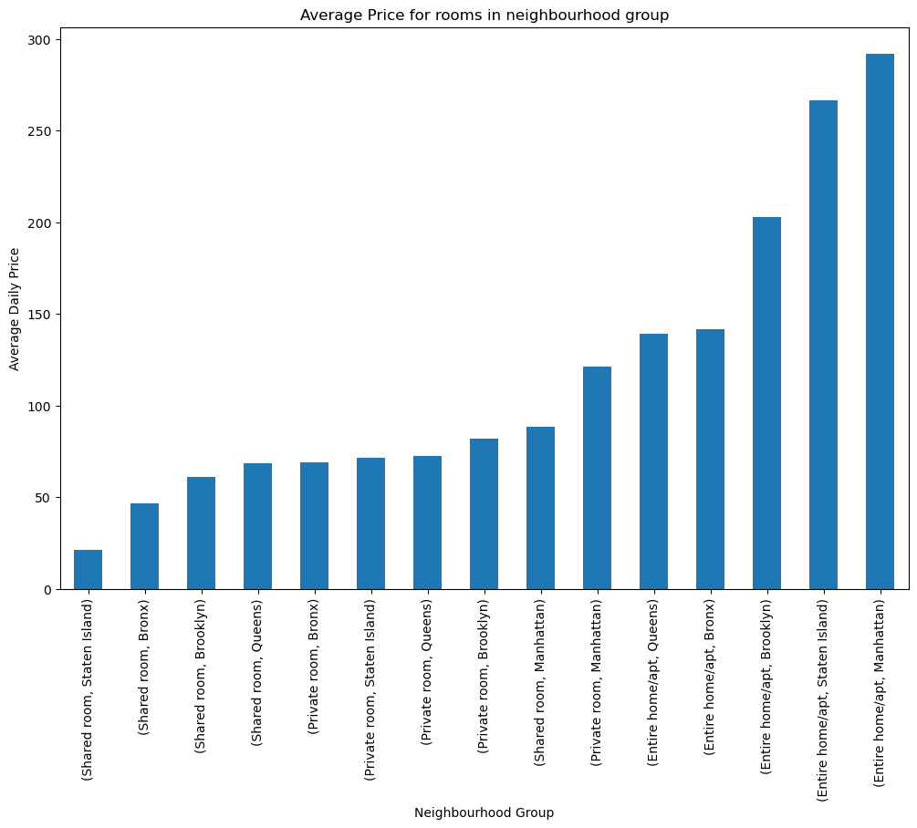
Average room rent for locality
For any traveler, the most important thing is the price since this sets the budget of his/her trip. So in the below we will figure out what is the average price per night. We will check for different room type and based on neighborhood group to figure out what is the average per night stay. Staying at a Apartment is always an expensive stay than shared room/private rooms for any location. This is so because Entire room is rented out by family for nice stay where privacy is also one of the major factor. Whereas Stay at Shared rooms are being preferred by travelers who generally don't wish to stay for long time at a particular place and moves around places quickly.
So looking at the plot it is clear :
a. Shared room at Staten Island is the most cheapest stay per night whereas Renting a Entire apartment/Home at Manhattan per night is the most expensive.
b. Average price for Private room is also considerably expensive at Manhattan so is the shared room at Manhattan is expensive than other private rooms of the neighborhood. This clearly states that Manhattan is the expensive stay than any other locality.
c. Bronx is the most cheapest stay in terms of neighborhood group comparison in respect to room type.
d. Though Shared room at Staten Island is the cheapest whereas Apartment renting is not cheapest at Staten Island. This can be due to the location of a perfect gateway from the rush of the city for a quality time with family get together , let me know what you think :).
We will also list out the average price for each type of room per neighborhood so that tourists can plan based on the budget.
ROOM_TYPE | NEIGHBOURHOOD | PRICE
Entire home/apt | Queens | 139.03626
 | Bronx | 141.54118
 | Brooklyn | 202.89525
 | Staten Island | 266.20513
 | Manhattan | 291.7846
Private room | Bronx | 69.025862
 | Staten Island | 71.394366
 | Queens | 72.454958
 | Brooklyn | 81.713284
 | Manhattan | 121.43418
Shared room | Staten Island | 21
 | Bronx | 46.711111
 | Brooklyn | 60.921212
 | Queens | 68.459459
 | Manhattan | 88.462898

Slide 20
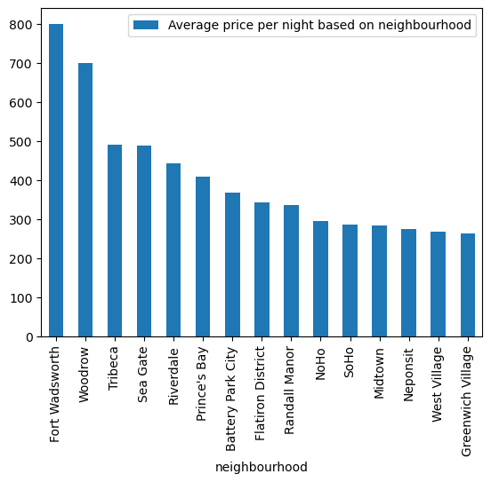
Expensive Neighborhood
Till so far we have checked on the location group, but we have not came across each neighborhood. This is very much important in terms of price to understand which locality has the highest price margin in terms of night being spend by travelers. Let's dig further to understand further.
So we will now plot the most expensive neighborhood, and we will plot only Top 15 neighborhood and Bottom 15 with respect to average price. This will help a travelers to choose the appropriate neighborhood based on his budget.
So according to the below plot Fort Wadsworth is the most expensive in terms of neighborhood. Whereas Bull's head locality is the least expensive to stay.
NEIGHBOURHOOD | AVERAGE PRICE PER NIGHT BASED ON NEIGHBOURHOOD
Fort Wadsworth | 800
Woodrow | 700
Tribeca | 490.638418
Sea Gate | 487.857143
Riverdale | 442.090909
Prince's Bay | 409.5
Battery Park City | 367.557143
Flatiron District | 341.925
Randall Manor | 336
NoHo | 295.717949
SoHo | 287.103352
Midtown | 282.719094
Neponsit | 274.666667
West Village | 267.682292
Greenwich Village | 263.405612

Slide 21
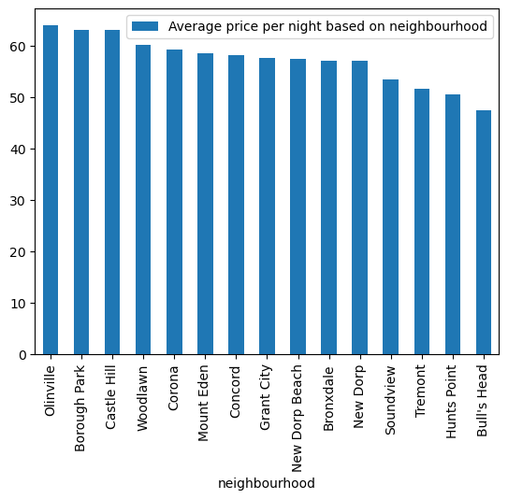
Least expensive neighborhood according to Airbnb listing are
NEIGHBOURHOOD | AVERAGE PRICE PER NIGHT BASED ON NEIGHBOURHOOD
Olinville | 64
Borough Park | 63.066176
Castle Hill | 63
Woodlawn | 60.090909
Corona | 59.171875
Mount Eden | 58.5
Concord | 58.192308
Grant City | 57.666667
New Dorp Beach | 57.4
Bronxdale | 57.105263
New Dorp | 57
Soundview | 53.466667
Tremont | 51.545455
Hunts Point | 50.5
Bull's Head | 47.333333

Slide 22
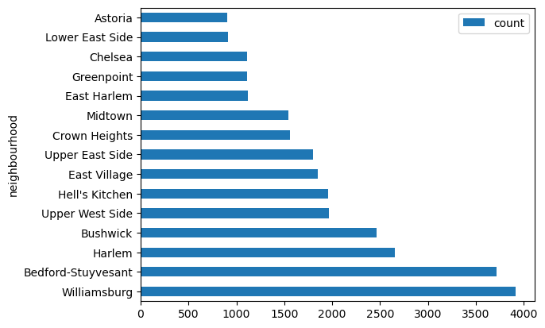
Most number of locality listed
NEIGHBOURHOOD | COUNT
Williamsburg | 3919
Bedford-Stuyvesant | 3714
Harlem | 2656
Bushwick | 2464
Upper West Side | 1970
Hell's Kitchen | 1955
East Village | 1853
Upper East Side | 1797
Crown Heights | 1563
Midtown | 1545
East Harlem | 1116
Greenpoint | 1113
Chelsea | 1112
Lower East Side | 911
Astoria | 900
We will now try to figure out how many number of neighborhood has been posted based on the count. We can see Williamsburg has most number of listing count where as Fort Wadsworth has one of the least listing i.e. 1.
I have listed below the listing of top 15 as well as least 15 based on the neighborhood.
If we recall this neighborhood is one of the highest stay based on price so this can be one of the reason that the price is increased due to the less number of listing.

Slide 23
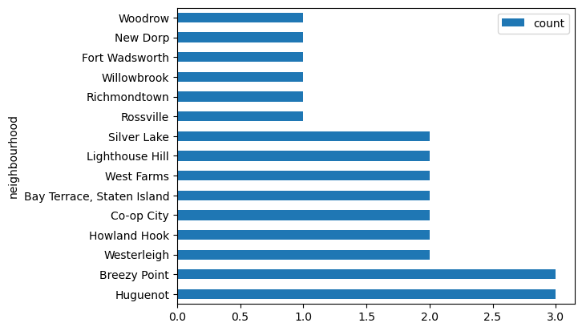
Least Listing number of count
NEIGHBOURHOOD | COUNT
Huguenot | 3
Breezy Point | 3
Westerleigh | 2
Howland Hook | 2
Co-op City | 2
Bay Terrace, Staten Island | 2
West Farms | 2
Lighthouse Hill | 2
Silver Lake | 2
Rossville | 1
Richmondtown | 1
Willowbrook | 1
Fort Wadsworth | 1
New Dorp | 1
Woodrow | 1

Slide 24
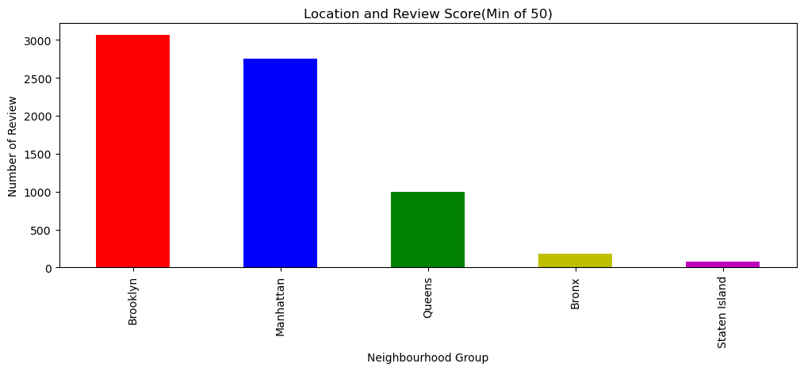
Location and Review Score
Review is the one of the important criteria with online activity these days. This gives a lot of insights to a particular place for tourist and they can swing mood when it comes to online booking. A cheap place with bad review can drive a tourist for not booking and an expensive place with nicest review can shell a tourist more than what he have thought initially. So we will try to figure out the review , how each neighborhood is doing in respect to review. Since there is a limited data with review we will try to figure out as much as we can.
First criteria of our review is we will consider only those who have a review more than 50, so that we can have an insight of the data.
So according to the below plot, Brooklyn got most review in comparison to Manhattan and that is an interesting find. Also Staten Island which is cheaper has less review than the other neighborhood group. We cannot proceed further to understand why is that case since we have a limited data.
neighbourhood_group
Brooklyn | 3065
Manhattan | 2751
Queens | 997
Bronx | 187
Staten Island | 81

Slide 25
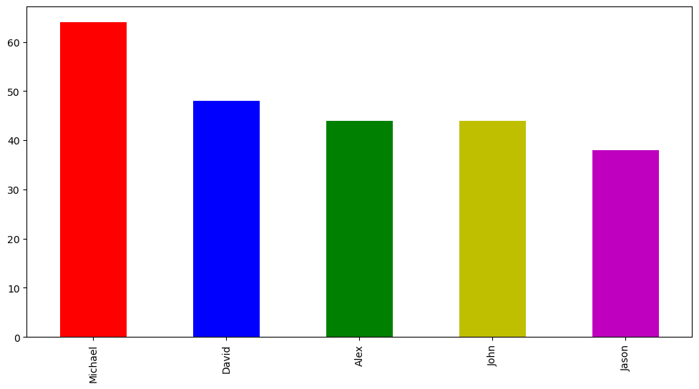
Top 5 host
Based on the review score(Minimum 50) we will plot, who is our top 5 Host, this increases the confidence of tourist before booking.
Also lets plot based on the latitude and location of our review data.

Slide 26
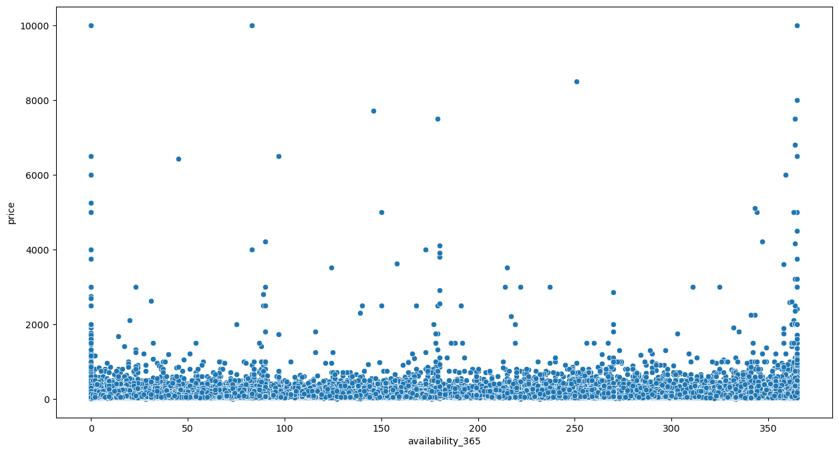
Plot Price based on the Availability 365
We will plot a scatterplot to understand if there is any price increase based on the availability and looking below the plot its hardly to infer. But looks like with availability with 365 the price increases to 10K.

Slide 27
Average Listing for each Neighborhood group
neighbourhood_group | room_type | host_id | latitude | longitude | price | minimum_nights | number_of_reviews | availability_365
Bronx | Entire home/apt | 6.83E+07 | 40.84557 | -73.87444 | 107 | 2.2125 | 101.325 | 197.3875
 | Private room | 5.77E+07 | 40.84801 | -73.89445 | 53.132075 | 2.084906 | 100.566038 | 177.660377
 | Shared room | 8.61E+07 | 40.84034 | -73.83007 | 20 | 1 | 116 | 5
Brooklyn | Entire home/apt | 3.80E+07 | 40.68182 | -73.95047 | 158.78296 | 3.921023 | 109.513068 | 171.889773
 | Private room | 3.72E+07 | 40.68403 | -73.94845 | 71.594192 | 2.731554 | 109.997645 | 155.525118
 | Shared room | 3.80E+07 | 40.66884 | -73.94136 | 40.806452 | 1.967742 | 105.322581 | 163.258065
Manhattan | Entire home/apt | 3.75E+07 | 40.76091 | -73.97544 | 218.53168 | 4.694829 | 106.79898 | 157.758194
 | Private room | 4.22E+07 | 40.77692 | -73.96827 | 97.856049 | 3.114855 | 117.383614 | 144.607198
 | Shared room | 7.22E+07 | 40.77273 | -73.97242 | 62.444444 | 1.916667 | 92.916667 | 170.402778
Queens | Entire home/apt | 6.50E+07 | 40.72809 | -73.86438 | 124.05301 | 2.725301 | 104.643373 | 184.93253
 | Private room | 7.47E+07 | 40.73366 | -73.86345 | 61.807356 | 2.402802 | 116.19965 | 187.637478
 | Shared room | 9.55E+07 | 40.71674 | -73.8435 | 43.181818 | 1.363636 | 122.454545 | 170.727273
Staten Island | Entire home/apt | 7.42E+07 | 40.6153 | -74.09838 | 105.65217 | 3.108696 | 95.065217 | 197.217391
 | Private room | 5.92E+07 | 40.62288 | -74.09683 | 54.714286 | 2.857143 | 105.742857 | 270.742857

Slide 28
Conclusion
Problem Statement
Are private Rooms preferred over other rooms types?
As per data We found Entire home & apartment preferred over other rooms types.
entire home/apt :- 52%
Private Room :- 45.7%
Shared Room :- 2.4 %
Is Manhattan Neighborhood more preferred over other neighborhoods?
Yes Manhattan neighborhood more preferred over other neighborhoods
Sonder(NYC) host is having most number of listings on Airbnb in NYC.
Fort Wadsworth is most expensive neighborhood average price per night based on neighborhood .
Bull's Head is Least expensive neighborhood.
Williamsburg neighborhood has most number of listings.
Rossvillen , Richmondtown , Willowbrook, Fort Wadsworth , New Dorp and Woodrow neighborhoods have costliest listing in NYC.
Brooklyn got most review in comparison to Manhattan and that is an interesting find. Also Staten Island which is cheaper has less review than the other neighborhood group.
Michael (host) has the highest total number_of_reviews.
Maximum listing are listed on Manhattan and Brooklyn neighbourhood_groups . Staten Island and Bronx neighbourhood_group have very less numbers of listings.
Most of the listings on Airbnb in NYC are either Entire Home/Apartment or Private Room . The people who prefer to stay in entire home/apartment are likely going to stay longer. Whereas people who prefer to stay in private_room are likely to stay for a shorter period of time than the people who prefer to stay in entire home/apartment.
Many rows are having values as 0 in price column, so this seems like an error which must be rectified by Airbnb.
Keeping high price of the listing and have 0 availability isn't benefitting the host as the consumer is ready to pay the price but even after that there are no available rooms then what's the benefit of paying such premium.

Slide 29
Thank You…

